Slide 1

Alcohol Consumption Importance to Student Grades Springboard Project
Olufemi George

Slide 2
The Project is to determine the correlation (if any) between alcohol consumption by students and their grades in 2 Portuguese Secondary Schools. We will also be looking at the importance/relevance of other variables in determining passing grades in this dataset based on the best performing model.
Project Overview
Notes:
This is the question that your experiment answers

Slide 3
This data shows Secondary School student achievement for two Portuguese schools. The data attributes include student grades, demographic, social and school related features) and was collected using school reports, surveys and questionnaires. The goal was to determine the correlation (if any) between alcohol consumption by students and their grades in school. We will also be looking at the importance/relevance of other variables in determining passing grades in this dataset based on the best performing model.
Project Overview
Notes:
This is the question that your experiment answers

Slide 4
The Data
The data attributes include student grades, demographic, social and school related features)
Collected by using school reports, surveys and questionnaires.
Two datasets are provided regarding the performance in two distinct subjects: Mathematics (mat) and Portuguese language (por).
Both Datasets were merged and we ended up with 959 Observations and 33 variables.
17% of our data contains students that failed. This is an important step because if the proportion was smaller than 15%, it would be considered a rare event and would be more challenging to model.

Slide 5
Data Dictionary
1 school - student's school (binary: 'GP' - Gabriel Pereira or 'MS' - Mousinho da Silveira) 2 sex - student's sex (binary: 'F' - female or 'M' - male) 3 age - student's age (numeric: from 15 to 22) 4 address - student's home address type (binary: 'U' - urban or 'R' - rural) 5 famsize - family size (binary: 'LE3' - less or equal to 3 or 'GT3' - greater than 3) 6 Pstatus - parent's cohabitation status (binary: 'T' - living together or 'A' - apart) 7 Medu - mother's education (numeric: 0 - none, 1 - primary education (4th grade), 2 â€“ 5th to 9th grade, 3 â€“ secondary education or 4 â€“ higher education) 8 Fedu - father's education (numeric: 0 - none, 1 - primary education (4th grade), 2 â€“ 5th to 9th grade, 3 â€“ secondary education or 4 â€“ higher education) 9 Mjob - mother's job (nominal: 'teacher', 'health' care related, civil 'services' (e.g. administrative or police), 'at_home' or 'other') 10 Fjob - father's job (nominal: 'teacher', 'health' care related, civil 'services' (e.g. administrative or police), 'at_home' or 'other') 11 reason - reason to choose this school (nominal: close to 'home', school 'reputation', 'course' preference or 'other') 12 guardian - student's guardian (nominal: 'mother', 'father' or 'other') 13 traveltime - home to school travel time (numeric: 1 - <15 min., 2 - 15 to 30 min., 3 - 30 min. to 1 hour, or 4 - >1 hour) 14 studytime - weekly study time (numeric: 1 - <2 hours, 2 - 2 to 5 hours, 3 - 5 to 10 hours, or 4 - >10 hours) 15 failures - number of past class failures (numeric: n if 1<=n<3, else 4) 16 schoolsup - extra educational support (binary: yes or no) 17 famsup - family educational support (binary: yes or no)
Notes:
Summarize your research in three to five points.

Slide 6
Data Dictionary (continued)
18 paid - extra paid classes within the course subject (Math or Portuguese) (binary: yes or no) 19 activities - extra-curricular activities (binary: yes or no) 20 nursery - attended nursery school (binary: yes or no) 21 higher - wants to take higher education (binary: yes or no) 22 internet - Internet access at home (binary: yes or no) 23 romantic - with a romantic relationship (binary: yes or no) 24 famrel - quality of family relationships (numeric: from 1 - very bad to 5 - excellent) 25 freetime - free time after school (numeric: from 1 - very low to 5 - very high) 26 goout - going out with friends (numeric: from 1 - very low to 5 - very high) 27 Dalc - workday alcohol consumption (numeric: from 1 - very low to 5 - very high) 28 Walc - weekend alcohol consumption (numeric: from 1 - very low to 5 - very high) 29 health - current health status (numeric: from 1 - very bad to 5 - very good) 30 absences - number of school absences (numeric: from 0 to 93) 31 G1 - first period grade (numeric: from 0 to 20) 31 G2 - second period grade (numeric: from 0 to 20) 32 G3 - final grade (numeric: from 0 to 20, output target)
Notes:
Summarize your research in three to five points.

Slide 7
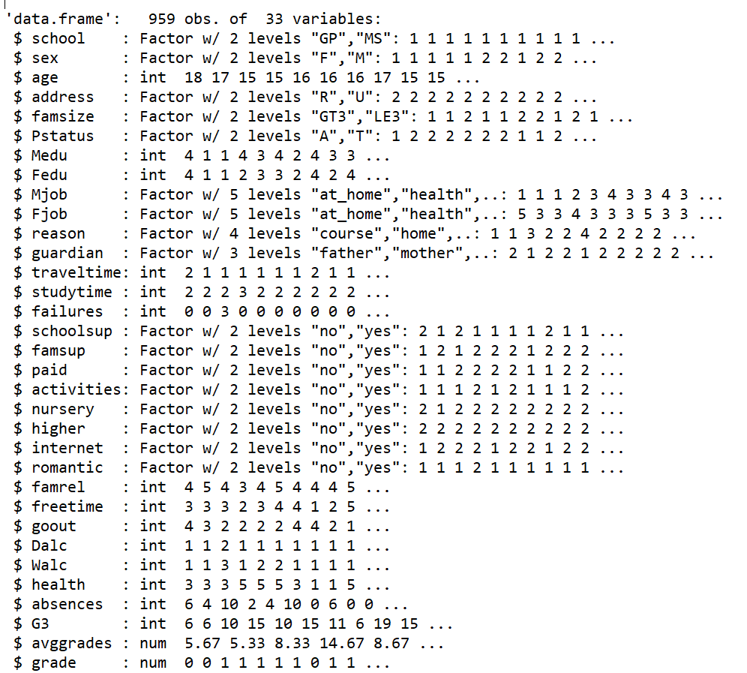
Data Structure
Notes:
Summarize your research in three to five points.

Slide 8
Target Variable
There were 3 grades G1,G2, and G3 representing first, second and final grades respectively.
Created a P/F variable based on passing mark for Schools in Portugal (In Portugal, exams are scaled on 0-20 with a pass mark of 9).
Notes:
Summarize your research in three to five points.

Slide 9
Exploratory Data Analysis
Data merged from two datasets.
No missing values were found Used ggplot2 and plot (stats) to examine central tendency and distribution of continuous variables (G3).
Each factor was converted into a separate binary variable with a value of either 1 or 0. This increased the number of variables from 32 to 53.
Notes:
Summarize your research in three to five points.

Slide 10
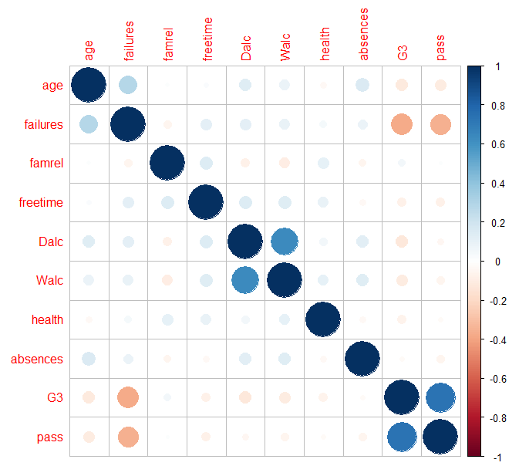
Testing correlation
Strong correlation between;
1) G3/failures
2) failures/pass
3) Walc/Dalc
4) age/failure
This shows that failure is a candidate for removal.
Notes:
Summarize your research in three to five points.

Slide 11
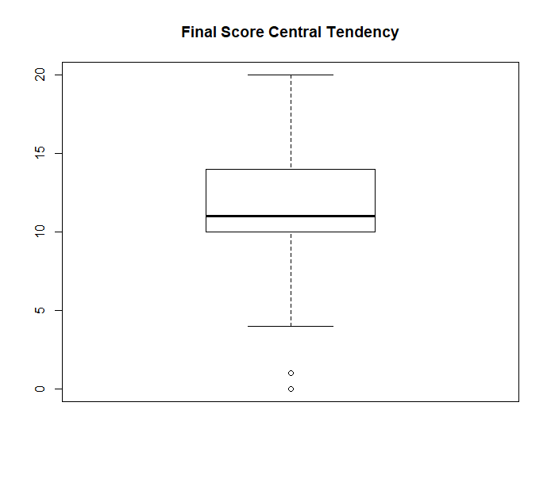
Exploring Final Score (G3)
Median score is over 10 which is a pass mark while there are 2 outliers.
Would be interesting to understand why there is a student has a zero score while it looks like the average minimum score is 5.
Is 5 the minimum score for just showing up for an exam?
Notes:
Summarize your research in three to five points.

Slide 12
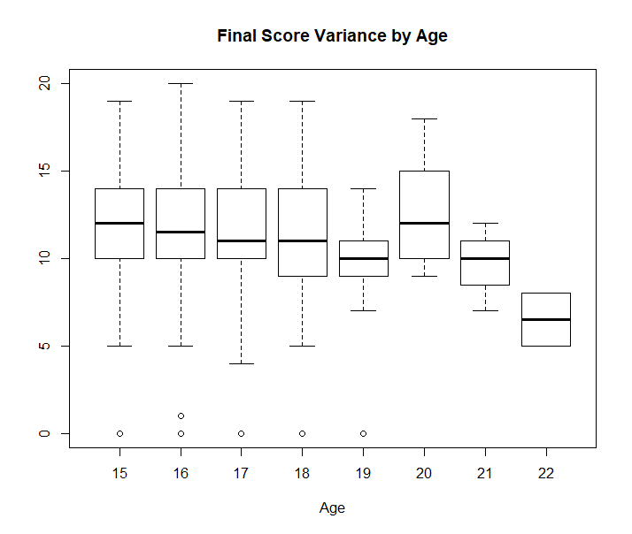
Age
The average final score and spread are relatively constant across the different ages between 15-19
The spread of scores of students who are 19 were smaller than average and from 19 years, there was a slight decline in average final scores.
This could be due to other factors related to age eg romantic relationships, alcohol etc
Notes:
Summarize your research in three to five points.

Slide 13
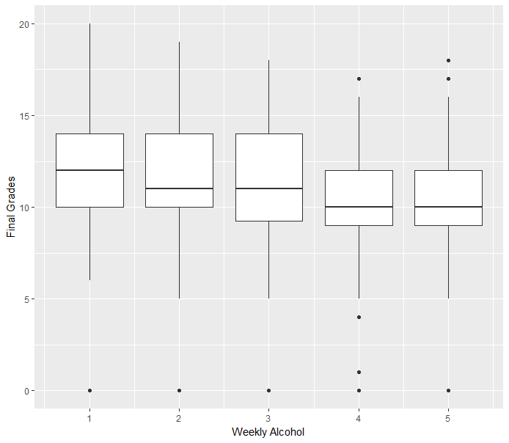
Weekly Alcohol Consumption and Final Grades
Median spread of grades are even across the alcohol consumption levels but fall slightly for levels 4 and 5 while the spread of grades across students is smaller for alcohol levels 4 and 5.
Notes:
Summarize your research in three to five points.

Slide 14
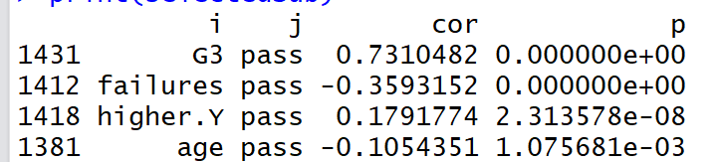
Variable Significance by Correlation
Used functions developed by Stephen Turner.
cor.prob will create a correlation matrix along with p-values and flattenSquareMatrix flattened all the combinations from the square matrix into a data frame of 4 columns made up of row names, column names, the correlation value and the p-value
Notes:
Summarize your research in three to five points.

Slide 15
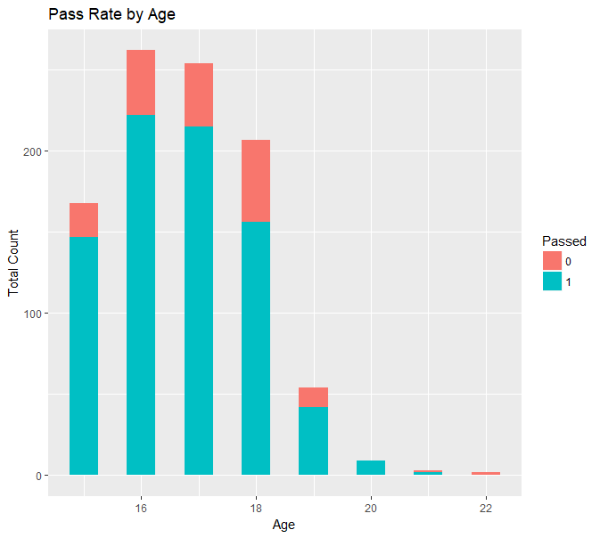
As age increases, the pass rate lowers especially from age 17
Does Age influence the Pass rate?
Notes:
Establish hypothesis before you begin the experiment. This should be your best educated guess based on your research.

Slide 16
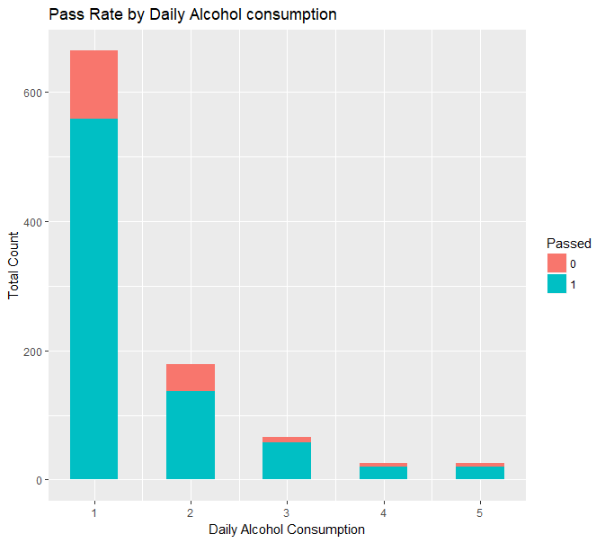
The pass rate fails from daily consumption levels 4. Most alcohol drinkers are in Category 1.
How does Daily consumption affect students passing rates?
Notes:
Establish hypothesis before you begin the experiment. This should be your best educated guess based on your research.

Slide 17
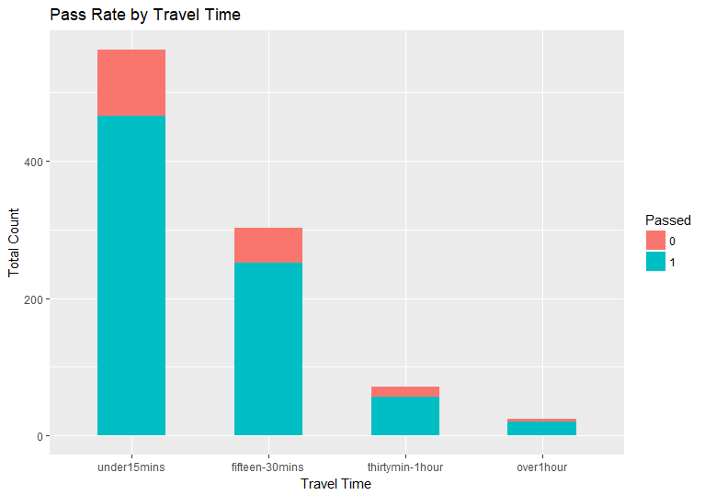
Pass rate falls with longer journeys. This could mean the students are not getting enough study time. Most students live nearby.
Does spending more time getting to school affect grades?
Notes:
Establish hypothesis before you begin the experiment. This should be your best educated guess based on your research.

Slide 18
Model choice considerations
Given that the data is all numeric, I would generally expect decision tree and rule-based methods to do well.
I would expect regression and instance-based methods to not do so well.
trainControl <- trainControl(method="repeatedcv", number=10, repeats=3, summaryFunction=twoClassSummary, classProbs = TRUE)
metric <- "ROC"
# GLM set.seed(7) fit.glm <- train(pass~., data=trainDF, method="glm", metric=metric, preProc=c("center", "scale"), trControl=trainControl)
Notes:
Summarize your research in three to five points.

Slide 19
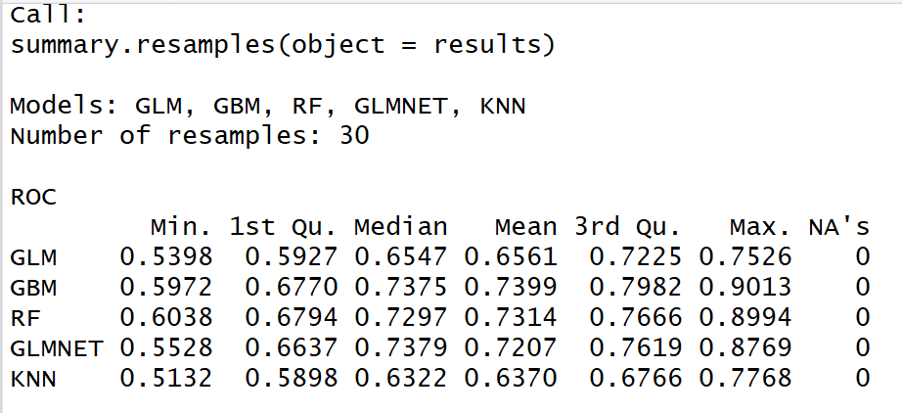
Algorithm results
Tested GLM, GBM, RF, GLMNET, KNN models without tuning and the metric was ROC.
GBM had the highest ROC accuracy of 0.7399
Notes:
Summarize your research in three to five points.

Slide 20
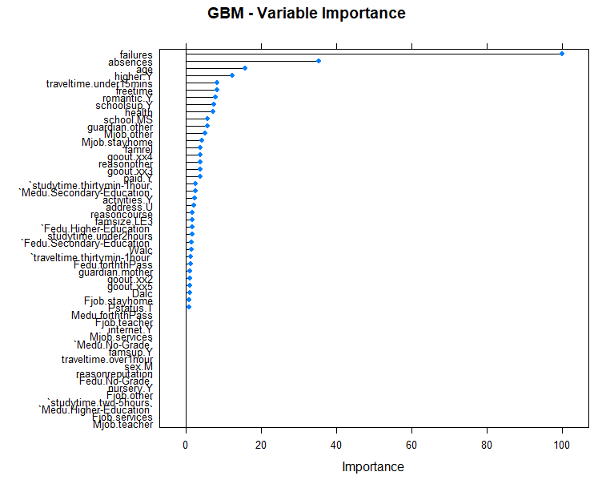
GBM Variable Importance (descending)
Failures
absences
age
HigherY
Traveltime.under15mins
freetime
romantic.Y
schoolsup.Y
Notes:
Summarize your research in three to five points.

Slide 21
Conclusion
Alcohol consumption (weekly or daily) are not variables of importance in predicting school grades.
Most important variables based on exploratory analysis are;
failure absences higher.Y age
After sampling 5 different algorithms, GBM was the best performing model with a ROC of 0.7399 and an Area under Curve (AUC) of 0.686
Model could be improved by Ensembling or removing variables form model that don’t contribute to it (PCA).

Slide 22
Works Cited
http://archive.ics.uci.edu/ml/datasets/student+performance

Slide 23
Analysis
Hypothesis
Notes:
Establish hypothesis before you begin the experiment. This should be your best educated guess based on your research.

Slide 24
Analysis
First research point
Second research point
Third research point
Notes:
Summarize your research in three to five points.

Slide 25
Feature Importance
First research point
Second research point
Third research point
Notes:
Summarize your research in three to five points.

Slide 26
Procedure
Step 1
Describe this step in your experiment
Step 2
Describe this step in your experiment
Step 3
Describe this step in your experiment
Step 4
Describe this step in your experiment
Notes:
List all of the steps used in completing your experiment.
Remember to number your steps.

Slide 27
Data/Observations
Include Observation based on the data from your experiments

